Slide 1

Hive Assignment – NYC Parking Violations
Student : Jagadish Janakiraman
Submission Date : 8/8/2022

Slide 2
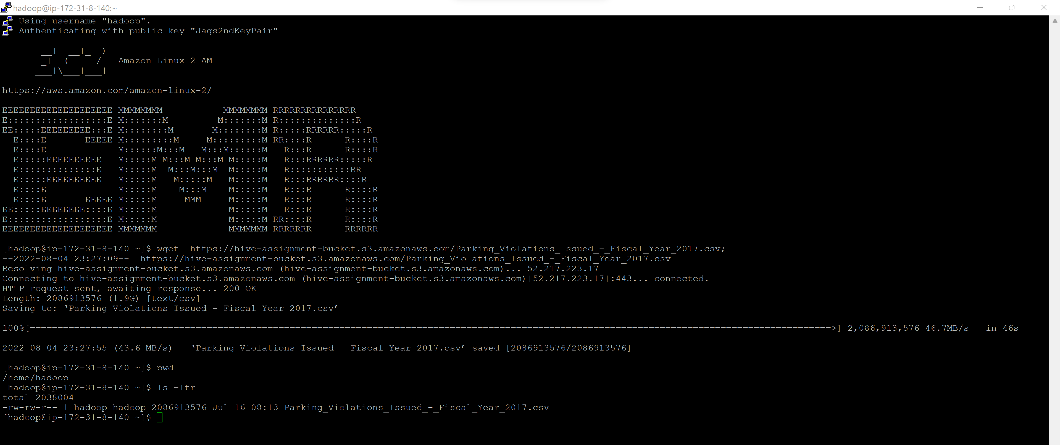
Load Data to EMR
Command –
wget https://hive-assignment-bucket.s3.amazonaws.com/Parking_Violations_Issued_-_Fiscal_Year_2017.csv;
Output Screenshot -

Slide 3
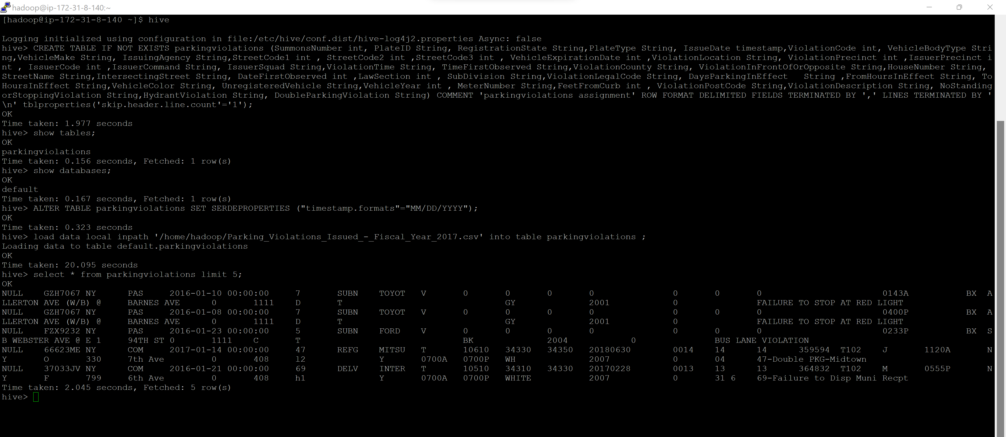
Load Data to Table
Commands are attached in file -
Output Screenshot -

Slide 4
Part-I: Examine the data

Slide 5
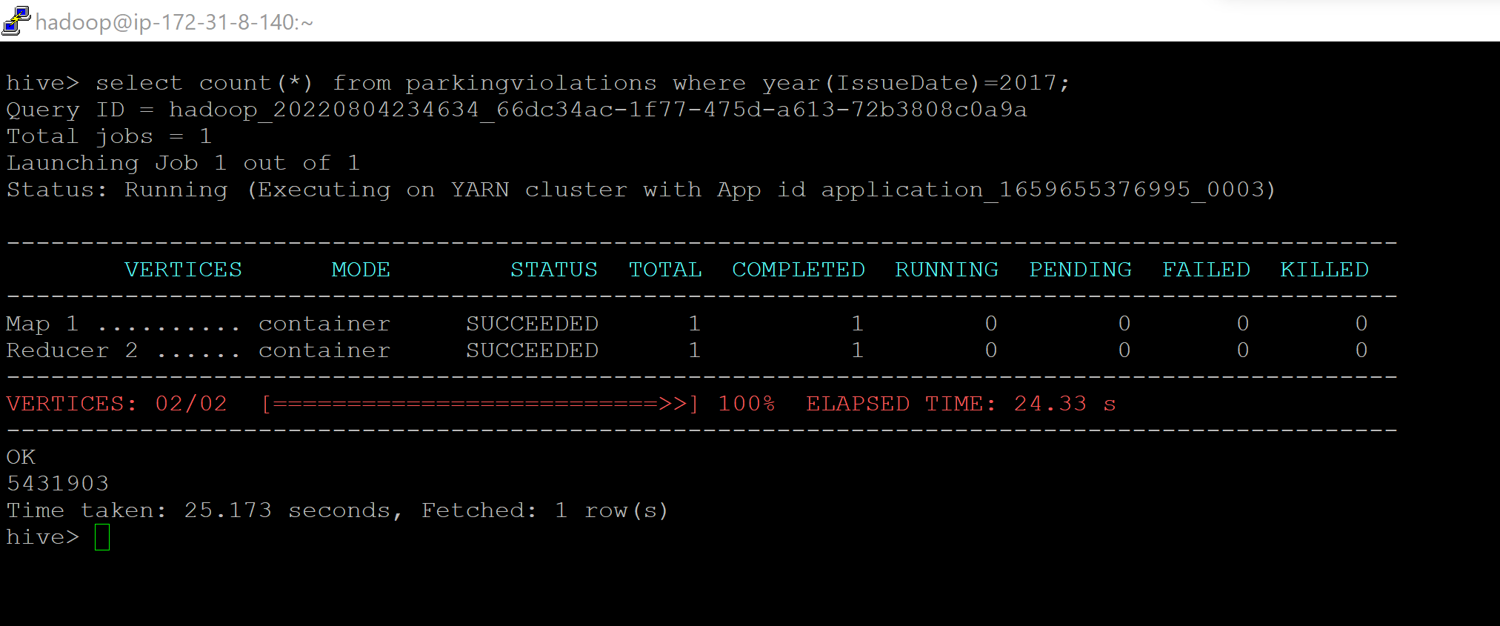
Q1.1 - Find the total number of tickets for the year.
Command - select count(*) from parkingviolations where year(IssueDate)=2017;
Answer – There are 5431903 parking violations in the year 2017
Output Screenshot -

Slide 6
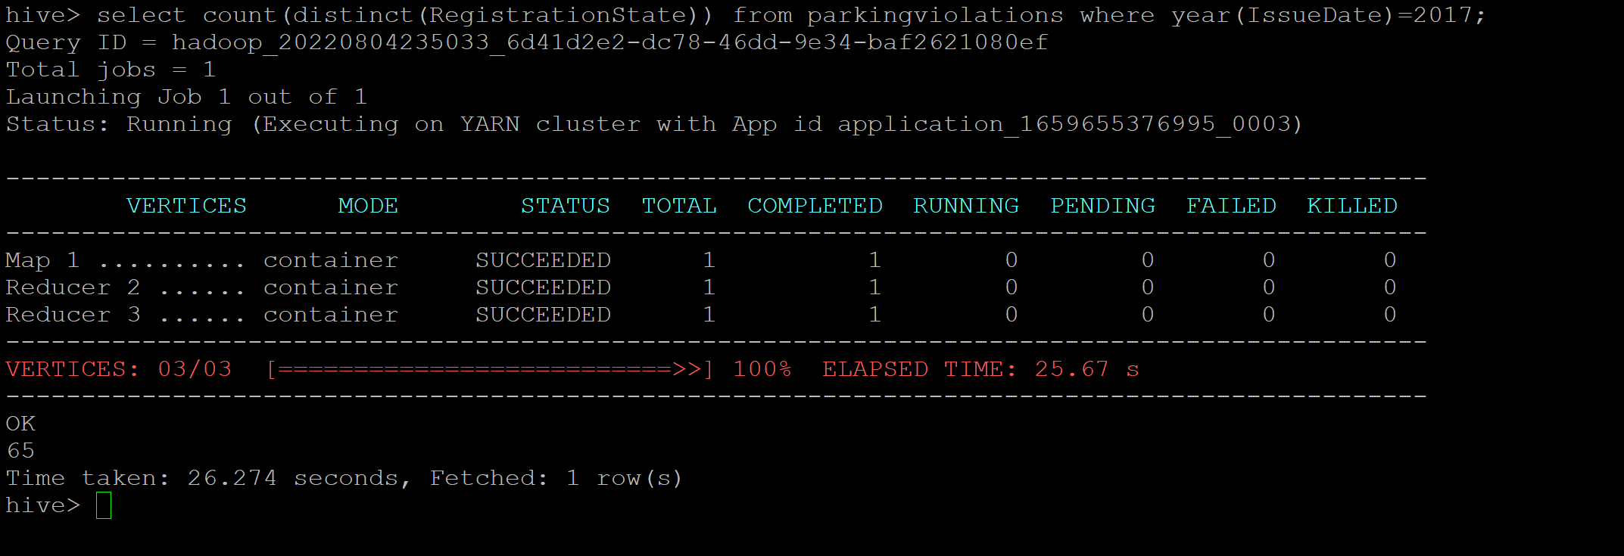
Q1.2 - Find out the total number of states to which the cars with tickets belong.
Command -select count(distinct(RegistrationState)) from parkingviolations where year(IssueDate)=2017;
Answer – Cars belong to 65 States with ticket
Output Screenshot -

Slide 7
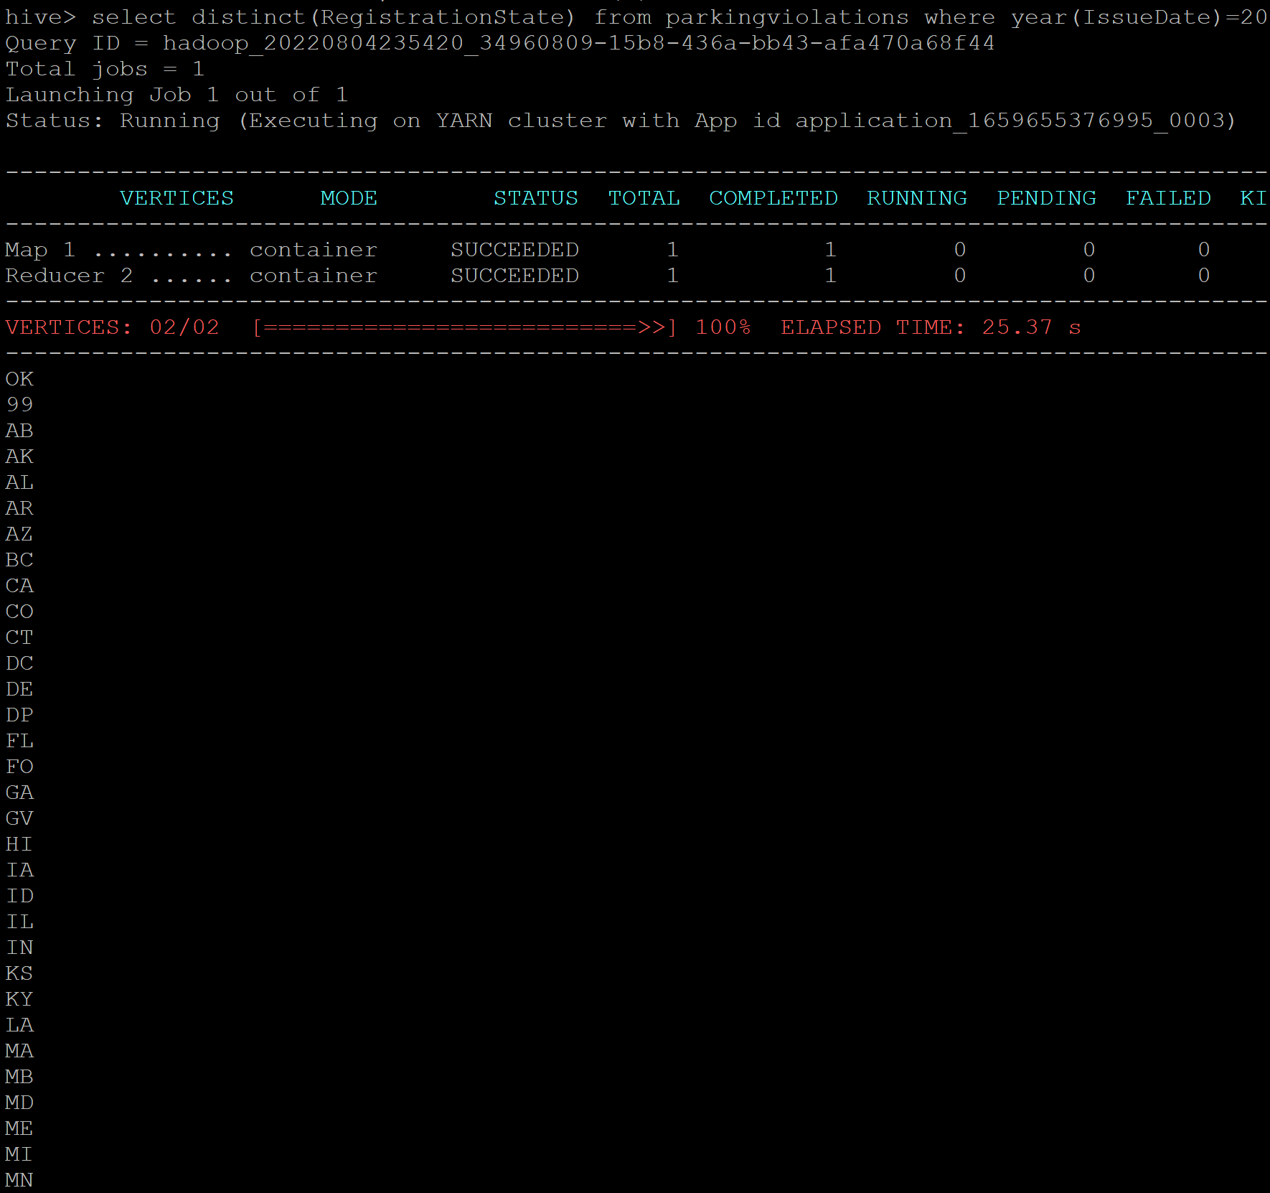
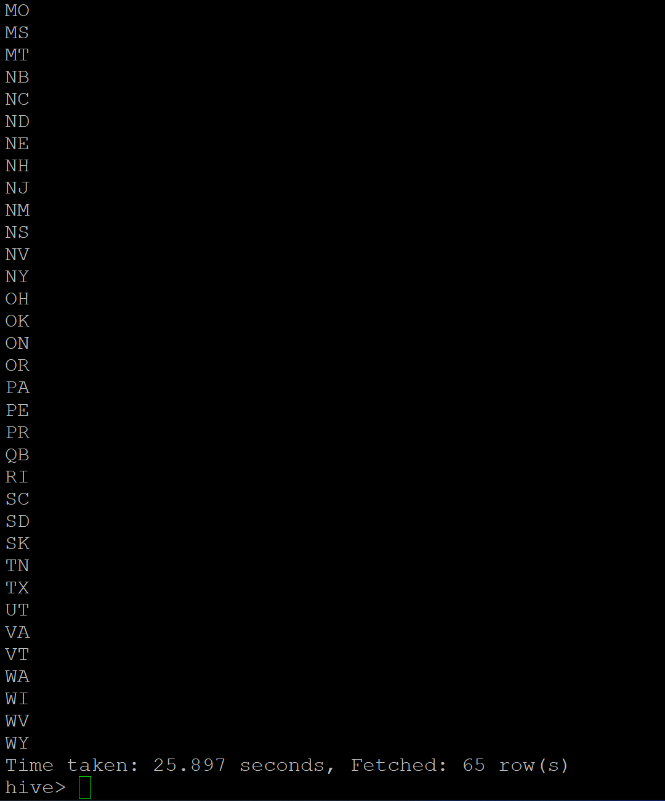
Q1.2 Optional Question – List of states with tickets
Command - select distinct(RegistrationState) from parkingviolations where year(IssueDate)=2017;
Answer – Cars belong to 65 States with ticket
Output Screenshot -

Slide 8
Q1.2 Optional Question – List of states with tickets
Command - select distinct(RegistrationState) from parkingviolations where year(IssueDate)=2017;
Answer – Cars belong to 65 States with ticket
Output Screenshot -

Slide 9
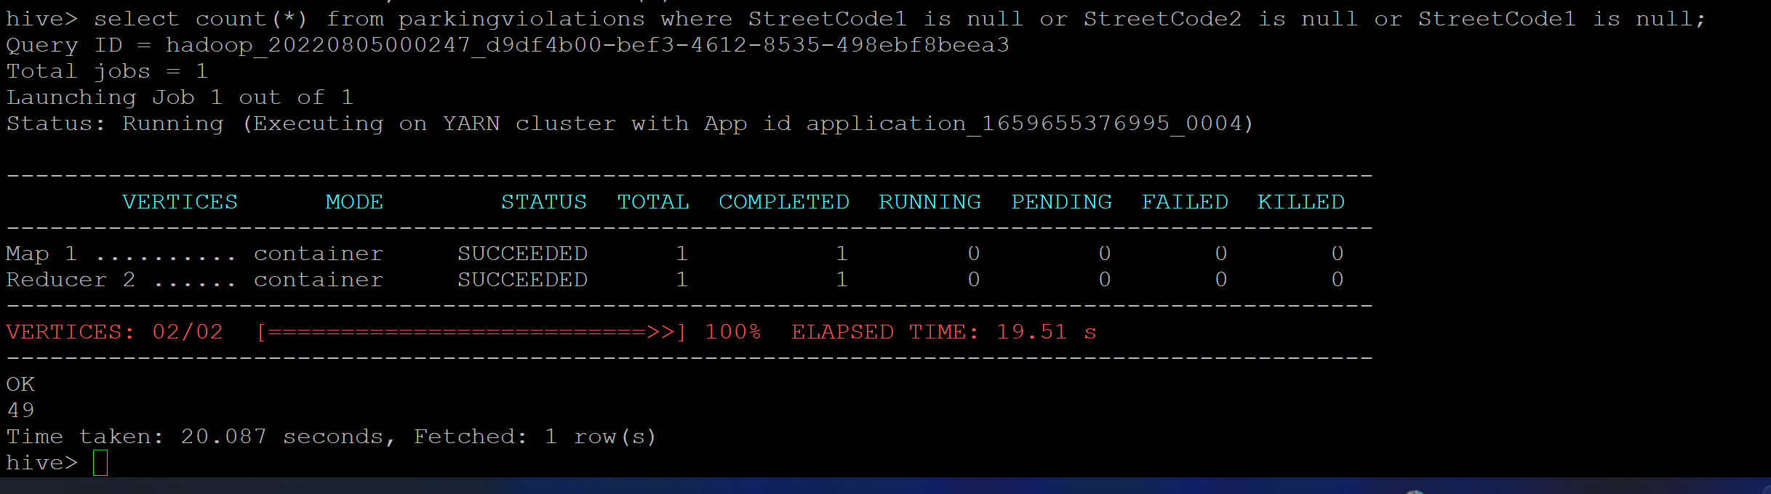
Q1.3 – Find out the number of such tickets which have no addresses.
Command - select count(*) from parkingviolations where StreetCode1 is null or StreetCode2 is null or StreetCode1 is null;
Answer – Cars belong to 65 States with ticket
Output Screenshot -

Slide 10
Part-II: Aggregation tasks

Slide 11
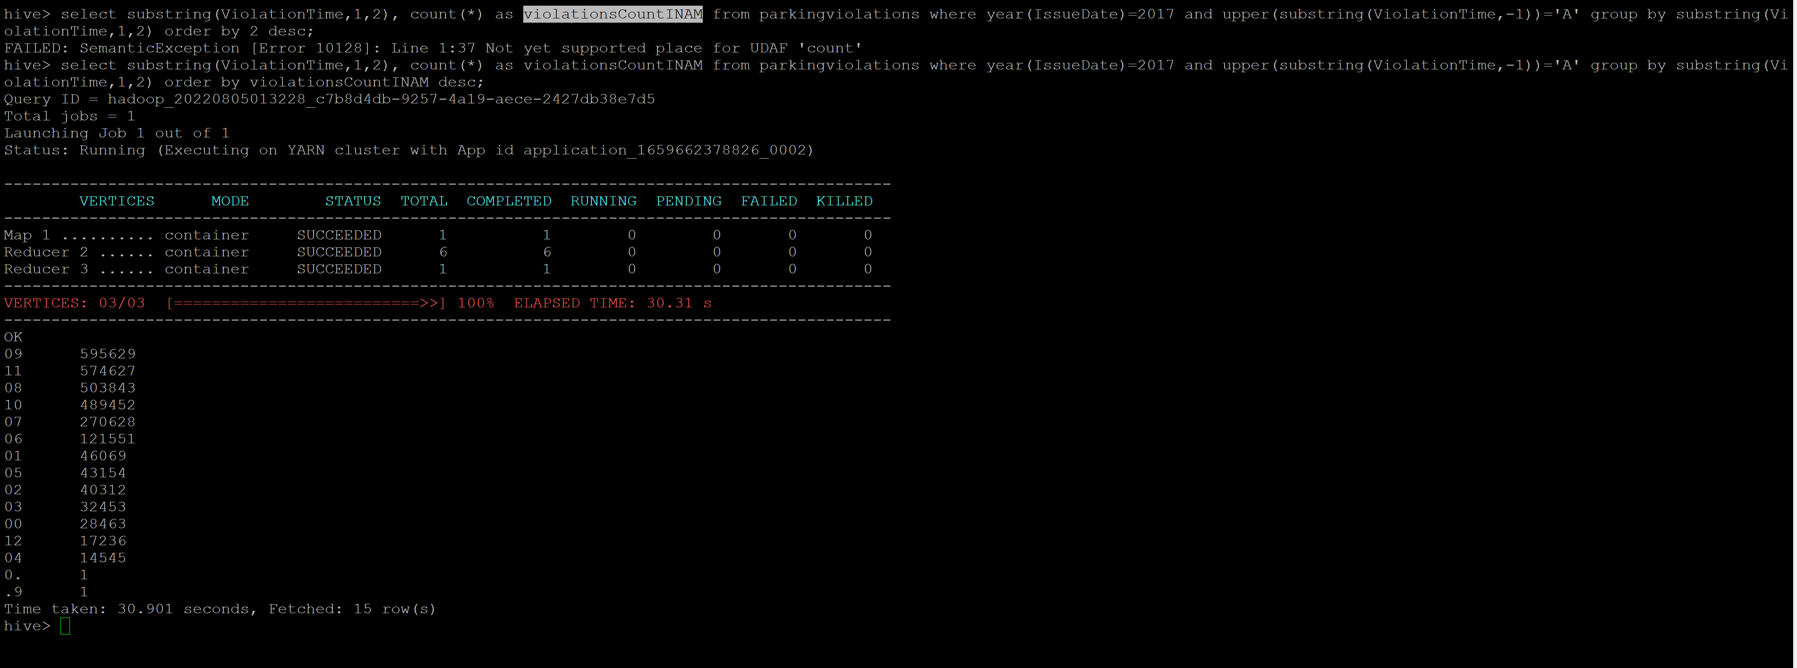
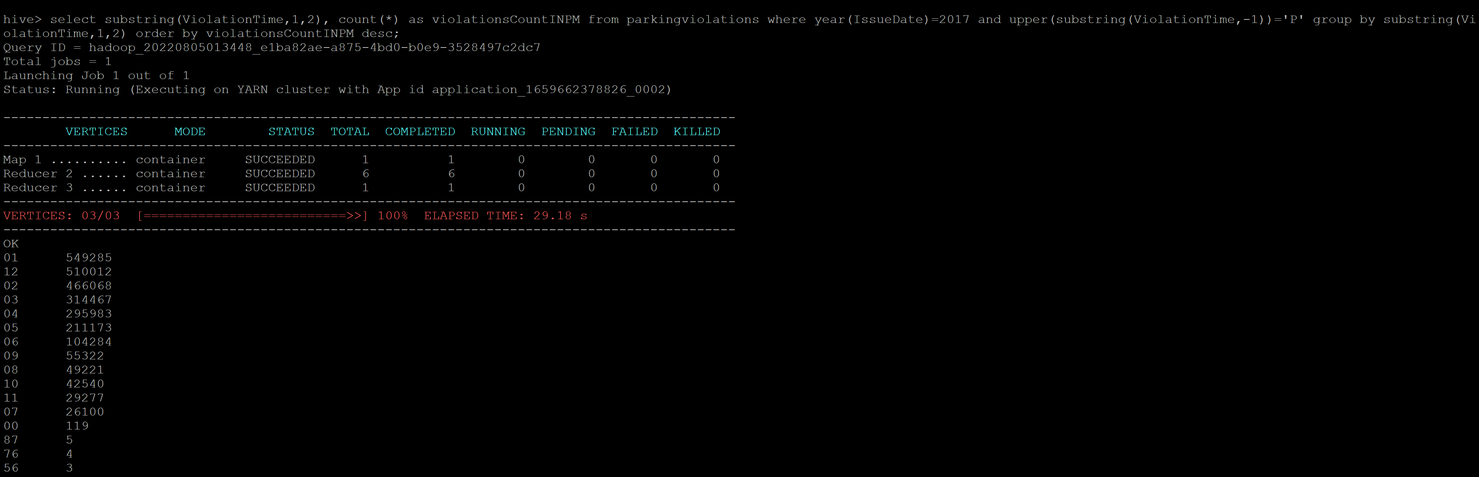
Q2.1 – Find out the frequency of parking violations across different times of the day
Command –
Vioations in AM - select substring(ViolationTime,1,2), count(*) as violationsCountINAM from parkingviolations where year(IssueDate)=2017 and upper(substring(ViolationTime,-1))='A' group by substring(ViolationTime,1,2) order by violationsCountINAM desc;
Violations in PM - select substring(ViolationTime,1,2), count(*) as violationsCountINPM from parkingviolations where year(IssueDate)=2017 and upper(substring(ViolationTime,-1))='P' group by substring(ViolationTime,1,2) order by violationsCountINPM desc;
Answer – 9 AM and 1 PM are the hours with maximum parking violations.
Output Screenshot -
Violations in AM
Violations in PM

Slide 12
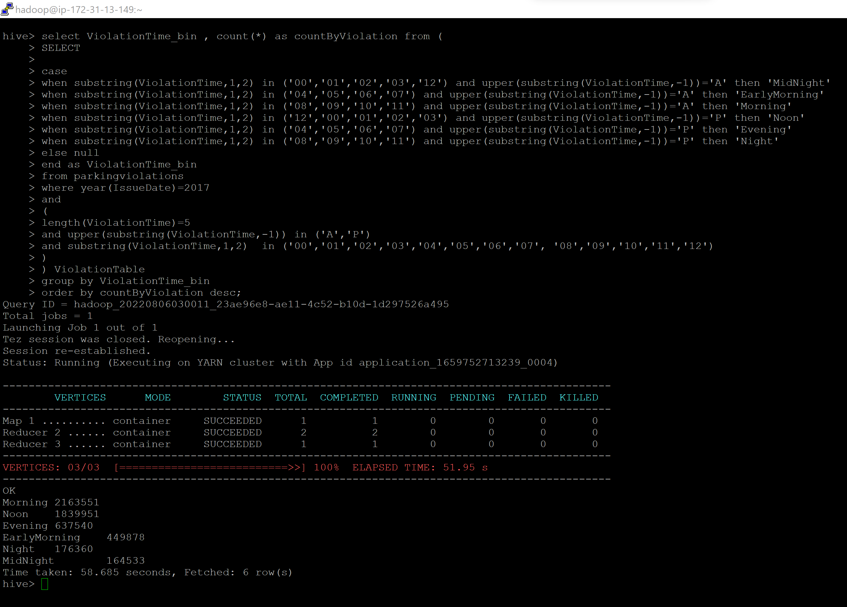
Q2.2 – Divide 24 hours into six equal discrete bins of time. The intervals you choose are at your discretion. For each of these groups, find the 3 most commonly occurring violations.
Command – SQL is attached
Output Screenshot -
Output – Violations Count By Time of Day
Morning 2,163,551
Noon 1,839,951
Evening 637,540
EarlyMorning 449,878
Night 176,360
MidNight 164,533

